Slide 1


Provably Efficient Offline Reinforcement Learning with Parametric Models
Ming Yin
Joint work with Mengdi Wang & Yu-Xiang Wang
10/17/2023
Computer Science Department
Notes:
(Hello Everyone, I am a final-year PhD student in Computer science department at UC Santa Barbara.) Thanks everyone for inviting me. I am really excited to be here, and to have the opportunity to tell you about my work. So let’s get started.

Slide 2
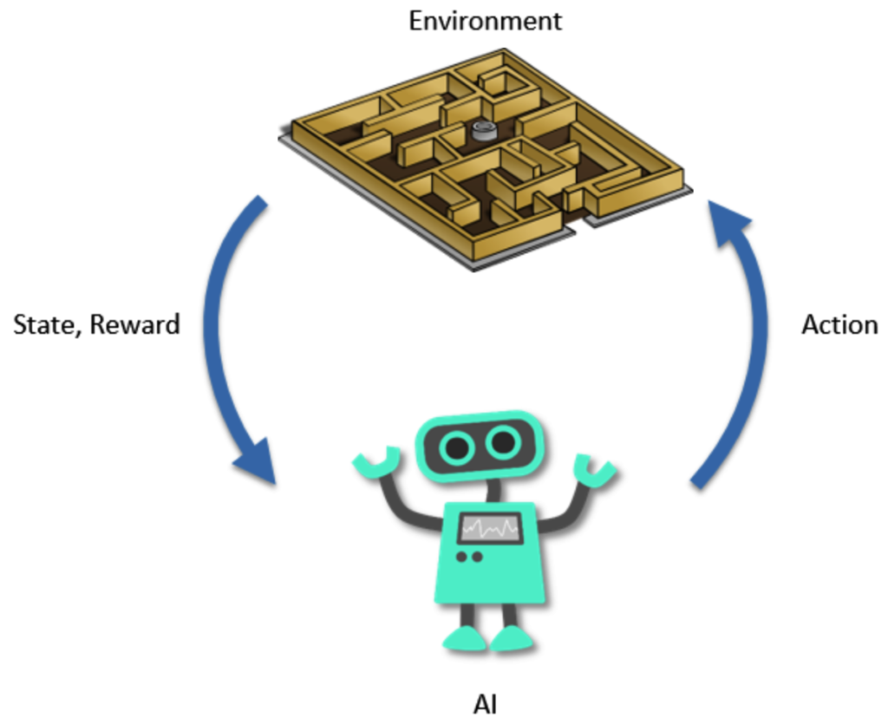
Reinforcement Learning
An RL agent learns interactively through the feedbacks of an environment.
2
Notes:
Reinforcement Learning is the problem of maximizing the cumulative reward via an RL agent learns interactively through the feedbacks of an environment.
The agent starts with a current state, and take an action, then the environment gives back an immediate reward and transition to the next state. Then the process repeats.

Slide 3

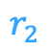
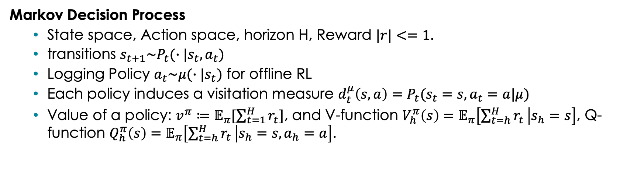
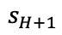
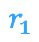
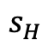
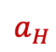
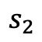

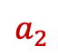
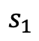
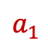
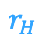
RL model: Markov Decision Processes
$$r_{1}$$
$$r_{2}$$
$$r_{H}$$
$$s_{1}$$
$$s_{2}$$
$$……$$
$$s_{H}$$
$$s_{H+1}$$
$$a_{1}$$
$$a_{2}$$
$$a_{H}$$
Markov Decision Process
State space, Action space, horizon H, Reward $|r|<=1$.
transitions $s_{t+1}\sim P_{t}(∙|s_{t},a_{t})$
Logging Policy $a_{t}\sim μ(∙|s_{t})$ for offline RL
Each policy induces a visitation measure $d_{t}^{μ}\left(s,a\right)=P_{t}(s_{t}=s,a_{t}=a|μ)$
Value of a policy: $v^{π}≔𝔼_{π}[\sum_{t=1}^{H}{r_{t}}]$, and V-function $V_{h}^{π}\left(s\right)=$ $𝔼_{π}\left[\sum_{t=h}^{H}{r_{t}} | s_{h}=s\right]$, Q-function $Q_{h}^{π}\left(s\right)=$ $𝔼_{π}\left[\sum_{t=h}^{H}{r_{t}} | s_{h}=s,a_{h}=a\right]$.
$$μ$$
[MDP example]
Call $π$ an $ε$-optimal policy if $v^{∗}−v^{π}≤ε$.
Notes:
The basic model for RL is markov decision process.

Slide 4
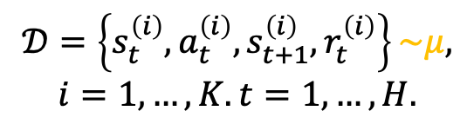
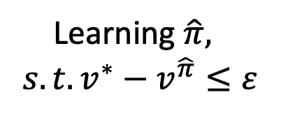
The goal of offline RL
Offline data
Learning $\hat{π},$
$$s.t. v^{∗}−v^{\hat{π}}≤ε$$
Offline (Policy) Learning
$$𝒟=\left\{s_{t}^{\left(i\right)},a_{t}^{\left(i\right)},s_{t+1}^{\left(i\right)},r_{t}^{\left(i\right)}\right\}\sim μ,$$
$$i=1,…,K. t=1,…,H.$$

Slide 5
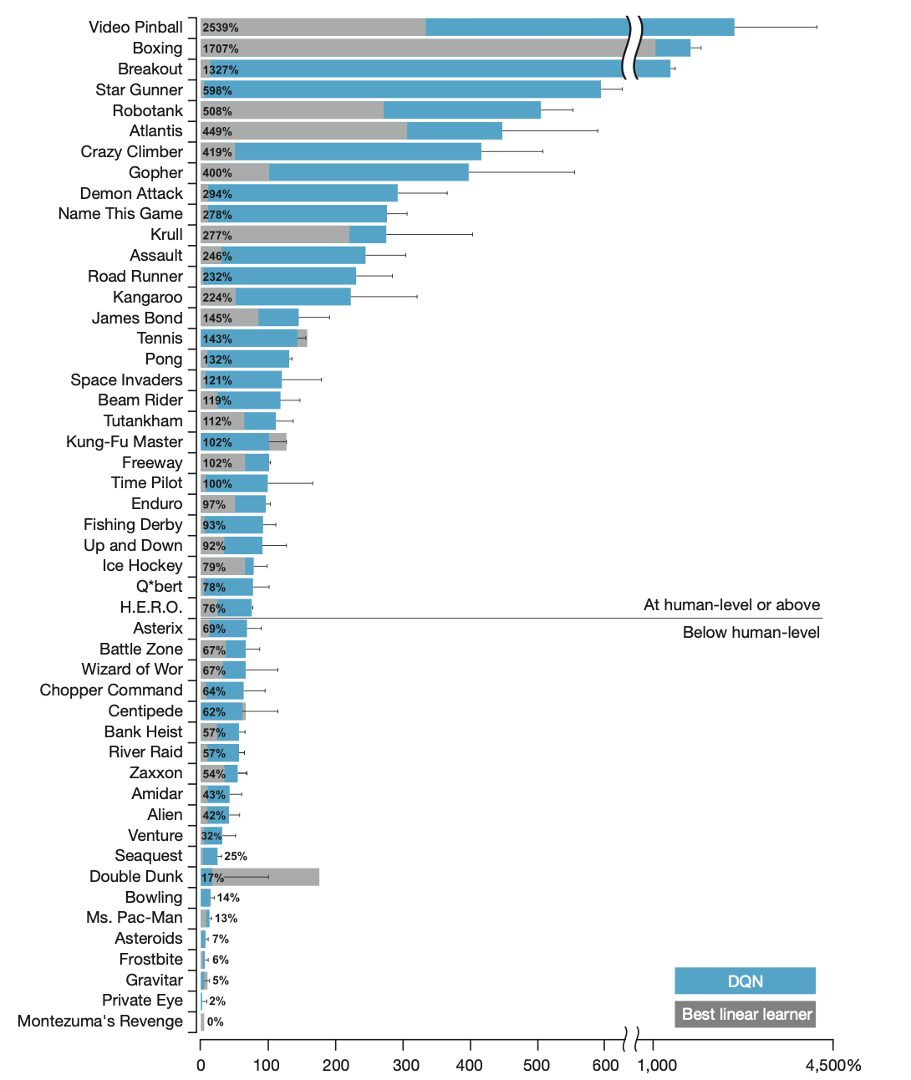
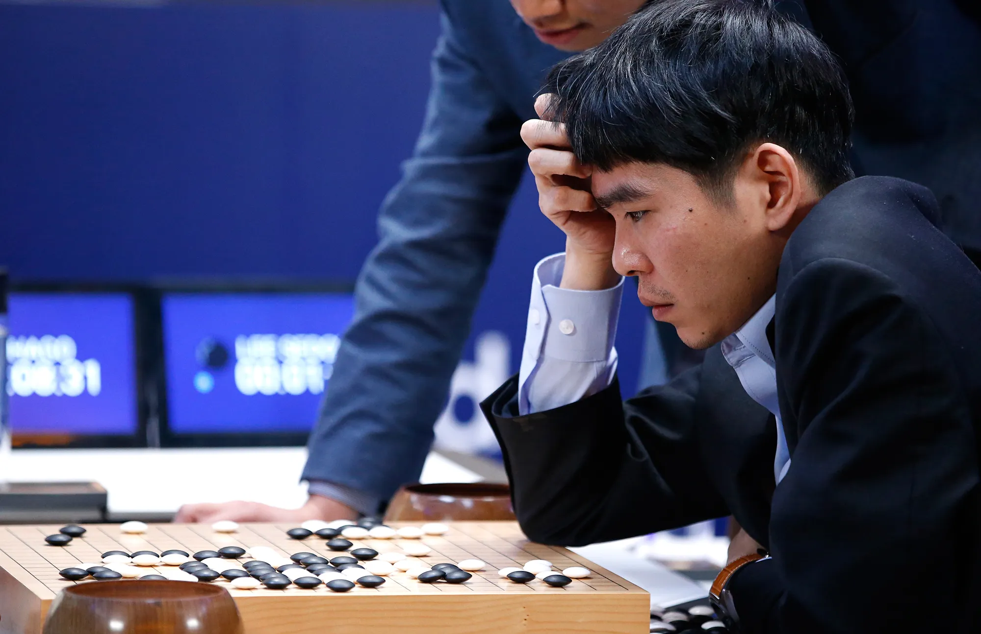

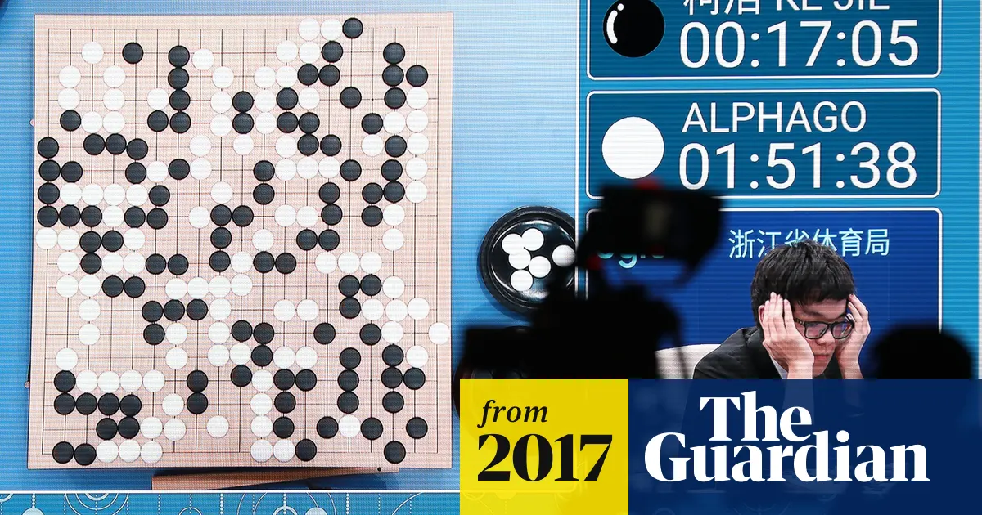
RL fanatic since AlphaGO
Many empirical successes in RL
DQN (Minh et al. 2015)
Alpha-Go/Zero (Sliver et al. 2016/17)
PPO->GPT-X (Schulman et al. 2017)
Use deep(-learning) models to learn!

Slide 6
Theoretically, we want (provable) data efficiency in offline RL
Tabular RL e.g. [Li et al. 21, Yin et al. 21, Rashidinejad et al. 21, Shi et al. 22]
Linear function e.g. [Jin et al. 2021, Duan et al. 2021a, Min et al. 21, Zanette et al. 21]
Parametric differentiable models
This talk
Deep-learning models are parametric!
Kernels e.g. [Jin et al. 2021, Duan et al. 2021b]
Semi-parametric [Kallus&Uehara 20], Besov spaces [Nguyen et al. 22, Ji et al. 2023]
General Function Approximation w/o structural assumption e.g. [Munos&Szepesva ́ri 08, Chen et al. 19, Uehara et al. 20, Xie et al. 21, Ozdaglar et al. 23]

Slide 7
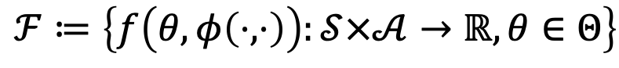
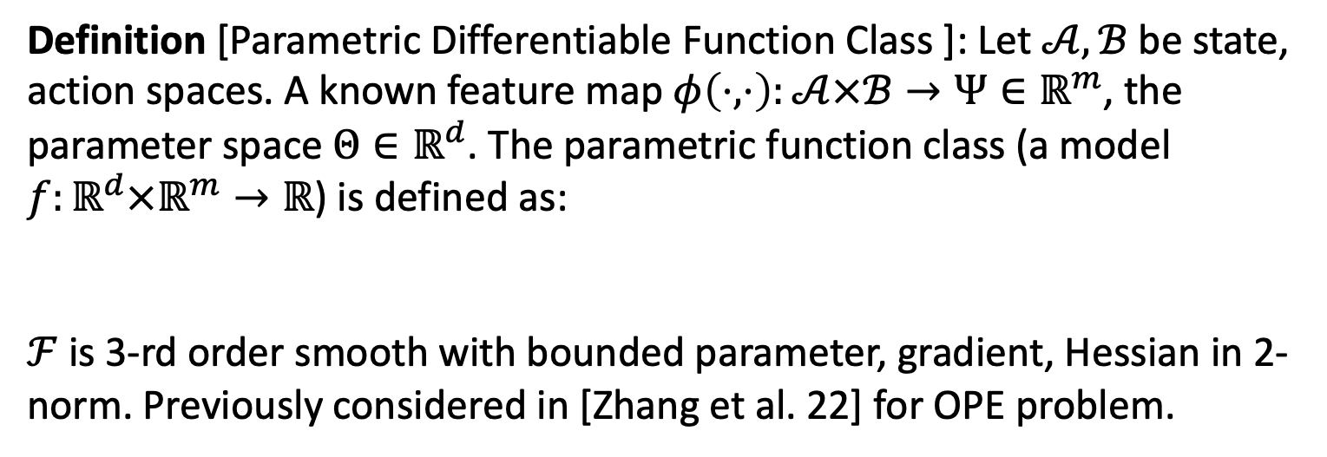
Preliminary
Definition [Parametric Differentiable Function Class ]: Let $𝒜,ℬ$be state, action spaces. A known feature map $φ\left(⋅,⋅\right):𝒜×ℬ→Ψ∈ℝ^{m}$, the parameter space $Θ∈ℝ^{d}$. The parametric function class (a model $f:ℝ^{d}×ℝ^{m}→ℝ$) is defined as:
$ℱ$ is 3-rd order smooth with bounded parameter, gradient, Hessian in 2-norm. Previously considered in [Zhang et al. 22] for OPE problem.
$$ℱ≔\left\{f\left(θ,φ\left(⋅,⋅\right)\right):𝒮×𝒜→ℝ,θ∈Θ\right\}$$

Slide 8
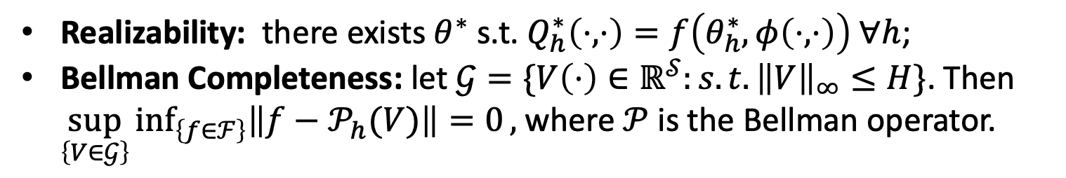
Assumptions
Realizability: there exists $θ^{∗}$ s.t. $Q_{h}^{∗}\left(⋅,⋅\right)=f\left(θ_{h}^{∗},φ\left(⋅,⋅\right)\right) ∀h$;
Bellman Completeness: let $𝒢=\{V\left(⋅\right)∈ℝ^{𝒮}:s.t. {\left\|V\right\|}_{∞}≤H\}$. Then $\sup_{\left\{V∈𝒢\right\}}\inf_{\left\{f∈ℱ\right\}}\left\|f−𝒫_{h}(V)\right\|=0,$ where $𝒫$ is the Bellman operator.
Notes:
"quadratic growth" condition is sufficient for getting linear convergence with smooth function class

Slide 9


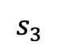
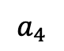

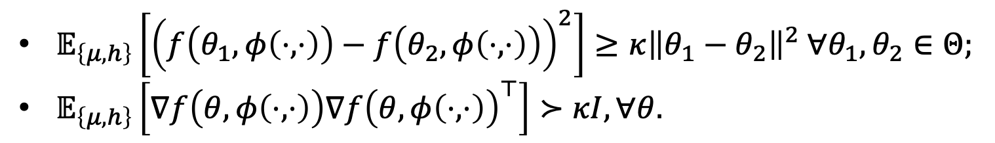
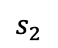
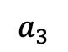
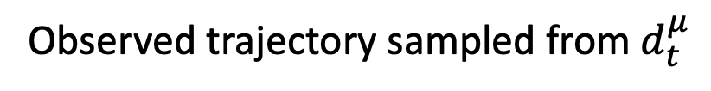
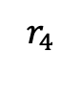
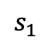
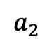
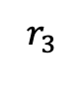
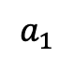
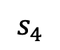
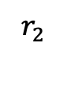
Challenges in Offline RL
Assumptions
Observed trajectory sampled from $d_{t}^{μ}$
$$r_{4}$$
$$r_{3}$$
$$a_{4}$$
Nothing, +0
…
$$a_{3}$$
$$r_{2}$$
…
$$a_{2}$$
$$s_{4}$$
…
$$s_{3}$$
+100
$$a_{1}$$
…
$$s_{1}$$
$$s_{2}$$
What you actually want: $d_{t}^{π^{∗}}$
Uniform Data Coverage
$𝔼_{\left\{μ,h\right\}}\left[{\left(f\left(θ_{1},φ\left(⋅,⋅\right)\right)−f\left(θ_{2},φ\left(⋅,⋅\right)\right)\right)}^{2}\right]≥κ{\left\|θ_{1}−θ_{2}\right\|}^{2} ∀θ_{1},θ_{2}∈Θ;$
$𝔼_{\left\{μ,h\right\}}\left[∇f\left(θ,φ\left(⋅,⋅\right)\right)∇f{\left(θ,φ\left(⋅,⋅\right)\right)}^{⊤}\right]≻κI, ∀θ.$
A "quadratic growth" condition [Anitescu, 00]
Notes:
"quadratic growth" condition is sufficient for getting linear convergence with smooth function class

Slide 10
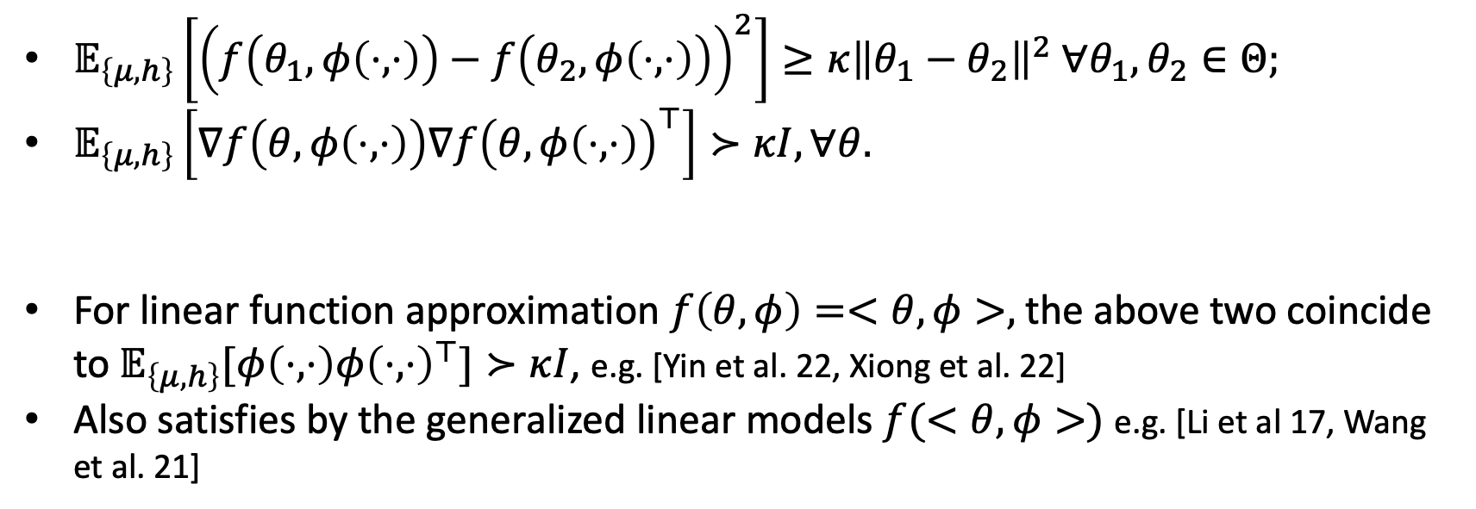
Assumptions
Uniform Data Coverage
$𝔼_{\left\{μ,h\right\}}\left[{\left(f\left(θ_{1},φ\left(⋅,⋅\right)\right)−f\left(θ_{2},φ\left(⋅,⋅\right)\right)\right)}^{2}\right]≥κ{\left\|θ_{1}−θ_{2}\right\|}^{2} ∀θ_{1},θ_{2}∈Θ;$
$𝔼_{\left\{μ,h\right\}}\left[∇f\left(θ,φ\left(⋅,⋅\right)\right)∇f{\left(θ,φ\left(⋅,⋅\right)\right)}^{⊤}\right]≻κI, ∀θ.$
For linear function approximation $f\left(θ,φ\right)=<θ,φ>,$ the above two coincide to $𝔼_{\left\{μ,h\right\}}[φ\left(⋅,⋅\right)φ{\left(⋅,⋅\right)}^{⊤}]≻κI$, e.g. [Yin et al. 22, Xiong et al. 22]
Also satisfies by the generalized linear models $f(<θ,φ>)$ e.g. [Li et al 17, Wang et al. 21]

Slide 11
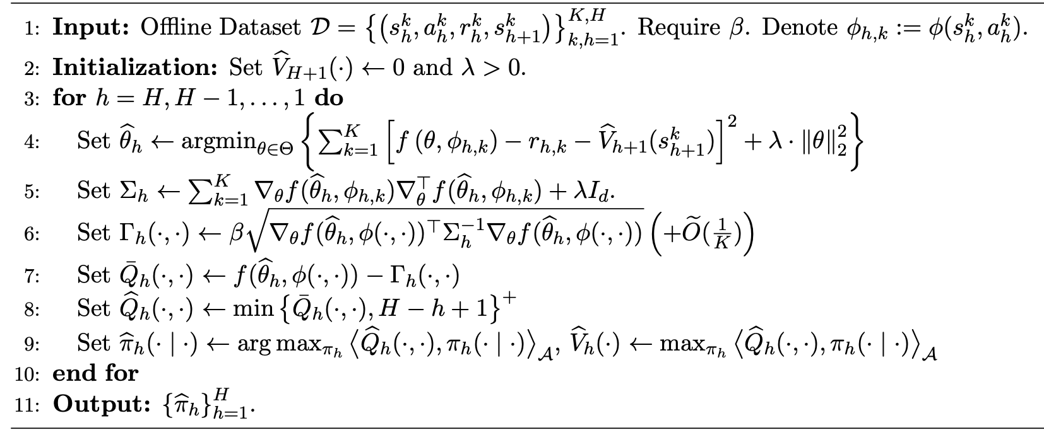
TL;DR: Pessimistic Fitted Q-Learning (PFQL)
Fitted Q
1st order covariance
Pessimistic update

Slide 12
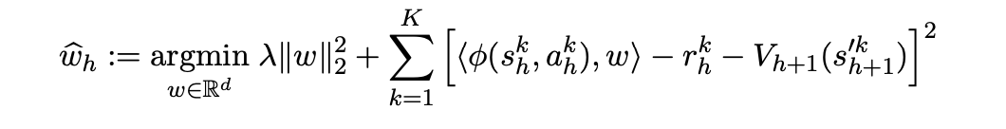
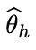
The challenges for analyzing the general parametric class
Linear case:
General model f:
Make the analysis for general model much harder

Slide 13
The challenges for analyzing the general parametric class
General model f:
This is related to minimizing the smooth score function using Z-estimator.
The Asymptotic normality theorem for Z-estimator [Kosorok M. R. 08] is not really helpful for obtaining finite sample guarantees.
Notes:
Kosorok, M. R. Introduction to empirical processes and semiparametric inference. Springer, 2008.

Slide 14
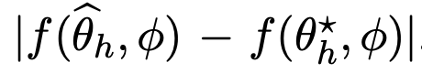
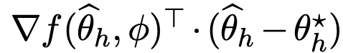
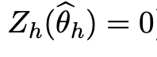
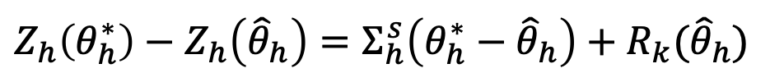

Our Technique
Goal:
$$≈$$
Estimate
is a stationary point!
All we have
Taylor expand
$$Z_{h}\left(θ_{h}^{∗}\right)−Z_{h}\left({\hat{θ}}_{h}\right)=Σ_{h}^{s}\left(θ_{h}^{∗}−{\hat{θ}}_{h}\right)+R_{k}({\hat{θ}}_{h})$$
Gradient matrix
Higher-order residuals
$${{θ_{h}^{∗}−{\hat{θ}}_{h}=\left(Σ_{h}^{s}\right)}^{−1}[Z}_{h}\left(θ_{h}^{∗}\right)−Z_{h}\left({\hat{θ}}_{h}\right)]−{\left(Σ_{h}^{s}\right)}^{−1}R_{k}({\hat{θ}}_{h})$$
Dominate error
“Quadratic growth” assumption for high-order residual

Slide 15
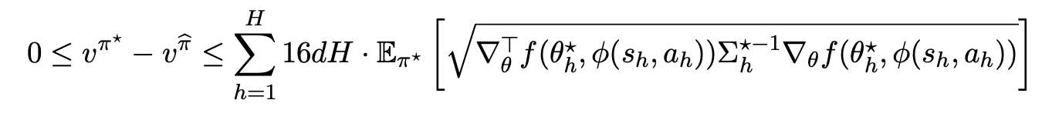
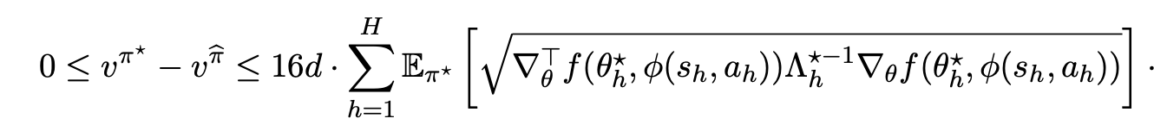
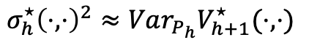
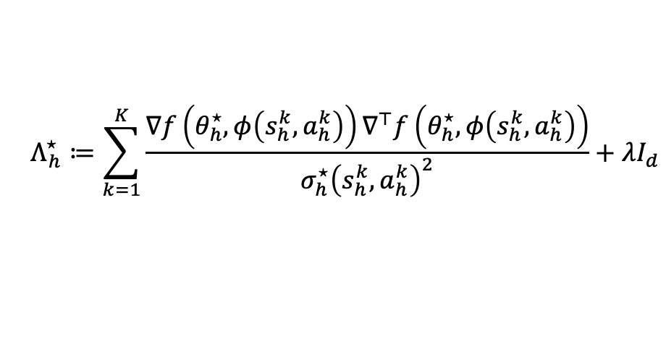
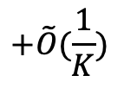
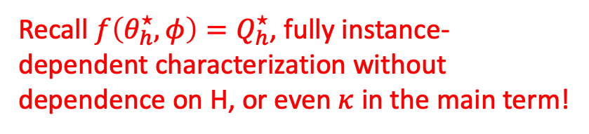
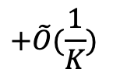

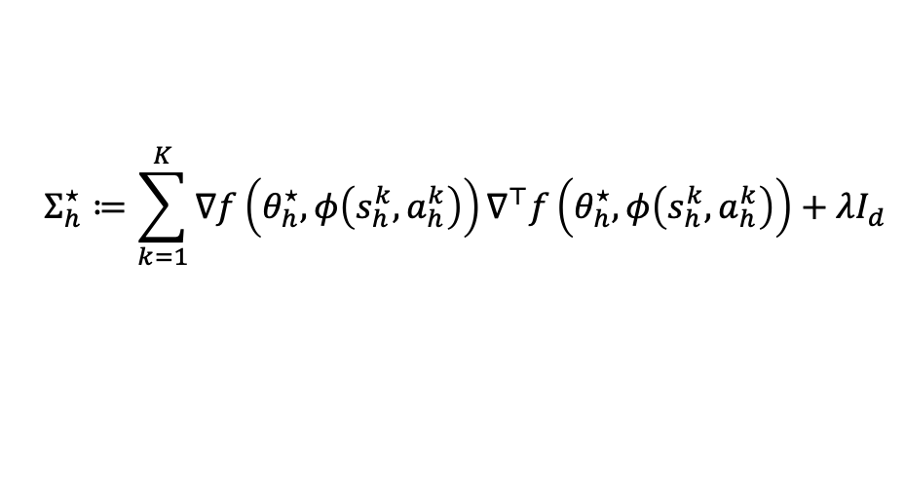

Our instance-dependent results: measured by first-order information and (weighted) covariance structure
PFQL
$$+\tilde{O}(\frac{1}{K})$$
w.p. $1−δ$
$$Σ_{h}^{⋆}≔\sum_{k=1}^{K}{∇f\left(θ_{h}^{⋆},φ\left(s_{h}^{k},a_{h}^{k}\right)\right)∇^{⊤}f\left(θ_{h}^{⋆},φ\left(s_{h}^{k},a_{h}^{k}\right)\right)}+λI_{d}$$
w.p. $1−δ$
PFQL+ Variance Awareness
$$+\tilde{O}(\frac{1}{K})$$
$$Λ_{h}^{⋆}≔\sum_{k=1}^{K}{\frac{∇f\left(θ_{h}^{⋆},φ\left(s_{h}^{k},a_{h}^{k}\right)\right)∇^{⊤}f\left(θ_{h}^{⋆},φ\left(s_{h}^{k},a_{h}^{k}\right)\right)}{σ_{h}^{⋆}{\left(s_{h}^{k},a_{h}^{k}\right)}^{2}}+λI_{d}}$$
Recall $f\left(θ_{h}^{⋆},φ\right)=Q_{h}^{⋆}$, fully instance-dependent characterization without dependence on H, or even $κ$ in the main term!
$$σ_{h}^{⋆}{\left(⋅,⋅\right)}^{2}≈Var_{P_{h}}V_{h+1}^{⋆}(⋅,⋅)$$

Slide 16

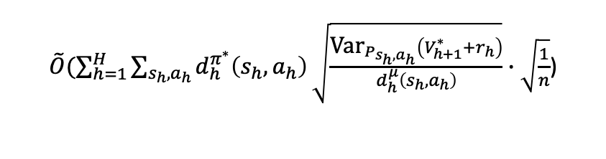







A line of instance-dependent offline RL bounds
Finite $S,A$
Discrete tabular RL
[YW2021,NeurIPS]
$\tilde{O}(\sum_{h=1}^{H}{\sum_{s_{h},a_{h}}{d_{h}^{π^{∗}}\left(s_{h},a_{h}\right)}\sqrt{\frac{{\text{Var}}_{P_{s_{h},a_{h}}}\left(V_{h+1}^{∗}+r_{h}\right)}{d_{h}^{μ}\left(s_{h},a_{h}\right)}}∙\sqrt{\frac{1}{n}}}$)
Continuous $S,A$
$$Q(s,a)=\left\langle θ,φ(s,a)\right\rangle$$
$$φ\left(s,a\right)=1_{s,a}$$
Continuous linear function approximation
[YDWW2022,ICLR]
$\tilde{O}(\sqrt{d}Σ_{h=1}^{H}𝔼_{π^{∗}}[\sqrt{{φ(s_{h},a_{h})}^{T}Λ_{h}^{−1}φ(s_{h},a_{h})}]$)
$$Λ_{h}≈Σ_{k=1}^{n}φ\left(s_{h}^{k},a_{h}^{k}\right)φ{\left(s_{h}^{k},a_{h}^{k}\right)}^{T}/σ_{V_{h+1}^{∗}}^{2}+λI$$
$$f\left(θ,φ\right)=\left\langle θ,φ(s,a)\right\rangle$$
Continuous $S,A$
$$Q(s,a)=f(θ,φ(s,a))$$
$\tilde{O}(d∙Σ_{h=1}^{H}𝔼_{π^{∗}}[\sqrt{∇_{θ}^{T}f(θ_{h}^{∗},φ(s_{h},a_{h})){∙Λ}_{h}^{∗−1}∙∇_{θ}f(θ_{h}^{∗},φ(s_{h},a_{h}))}]$)
This talk
[YWW2023,ICLR]
$$Λ_{h}^{∗}≈Σ_{k=1}^{n}∇_{θ}f(θ_{h}^{∗},φ\left(s_{h}^{k},a_{h}^{k}\right))∙∇_{θ}f(θ_{h}^{∗},φ{\left(s_{h}^{k},a_{h}^{k}\right))}^{T}/σ_{V_{h+1}^{∗}}^{2}+λI$$
Q: why are those results meaningful given the huge body of offline RL literatures?
16

Slide 17
On the interpretability of the instance-dependent results
(Using tabular MDP setup as an example)

Slide 18

Prior State-of-the-Art
 | $$v^{π^{∗}}−v^{\hat{π}}$$ | Assumption | Technique
[Xie&Jiang20] | $$\tilde{O}(\sqrt{\frac{H^{4}C_{μ}}{n}})$$ | (2) $\max_{π}{\max_{s,a,t}{\frac{d_{t}^{π}\left(s,a\right)}{d_{t}^{μ}\left(s,a\right)}}}≤C_{μ}$ | Minimax Bellman Error Minimization
[Yin et al.21] | $$\tilde{O}(\sqrt{\frac{H^{3}}{nd_{m}}})$$ | (1) $\min_{s,a,t}{d_{t}^{μ}\left(s,a\right)≥d_{m}>0}$ | Double Variance Reduction
[Xie et al. 21], [Rashidinejad et al. 21] [Shi et al. 22] | $$\tilde{O}(\sqrt{\frac{H^{3}SC^{∗}}{n}})$$ | (3) $\max_{s,a,t}{\frac{d_{t}^{π^{∗}}\left(s,a\right)}{d_{t}^{μ}\left(s,a\right)}}≤C^{∗}$ ($d_{m}≤1,C^{∗}≥1$) | Reference-Advantage Decomposition
Minimax optimal
Minimax optimal
18
Notes:
End: the last two results are minimax optimal, which means in the worst case, there is no algorithm that can have better guarantees than those results.

Slide 19






What is missing?
For 0.1-optimal policy, the minimax bound $n≈H^{3}/d_{m}$,
H=1000
+1
$$2$$
$$3$$
+0.999
H=1000
$$d_{m}≤1$$
L
R
$$1$$
For 0.1-optimal policy needs at least ${≈10}^{9}$ sample
For 0.1-optimal policy only needs 2 sample!
The minimax bound’s prediction is much larger than what is needed!
Notes:
However, there is a problem.

Slide 20




What is missing?
The performances of many problems are far better than what those bounds would suggest
Separate analysis for different assumptions:
Variance-reduction, Reference-Advantage decomposition
H=1000
For 0.1-optimal policy needs at least ${≈10}^{9}$ sample
+1
$$2$$
$$3$$
+0.999
Can we achieve one single result that explicitly describe the sample complexity for individual instances and also imply the existing optimal results?
L
R
H=1000
$$1$$
For 0.1-optimal policy only needs 2 sample!

Slide 21

Our Tabular Results [YW21]
Main Theorem: with probability $1−δ$, our algorithm use $n$ episodes of offline data that outputs a policy $\hat{π}$ such that
$$v^{π^{∗}}−v^{\hat{π}}≤\sum_{h=1}^{H}{\sum_{s_{h},a_{h}}{d_{h}^{π^{∗}}\left(s_{h},a_{h}\right)}\sqrt{\frac{{\text{Var}}_{P_{s_{h},a_{h}}}\left(V_{h+1}^{∗}+r_{h}\right)}{d_{h}^{μ}\left(s_{h},a_{h}\right)}}∙\sqrt{\frac{1}{n}}+\tilde{O}\left(\frac{1}{nd_{m}}\right)}$$
Main Message: the learning hardness is a mixed effect of distribution mismatch and environmental variations!
[YW21,NeurIPS] Towards Instance-Optimal Offline Reinforcement Learning with Pessimism

Slide 22




Comparing with previous results
$$v^{π^{∗}}−v^{\hat{π}}≤\sum_{h=1}^{H}{\sum_{s_{h},a_{h}}{d_{h}^{π^{∗}}\left(s_{h},a_{h}\right)}\sqrt{\frac{{\text{Var}}_{P_{s_{h},a_{h}}}\left(V_{h+1}^{∗}+r_{h}\right)}{d_{h}^{μ}\left(s_{h},a_{h}\right)}}∙\sqrt{\frac{1}{n}}+\tilde{O}\left(\frac{1}{nd_{m}}\right)}$$
$$\tilde{O}\left(\sqrt{\frac{H^{3}}{n∙d_{m}}}\right)$$
$$\tilde{O}\left(\sqrt{\frac{H^{3}SC^{∗}}{n}}\right)$$
$$\tilde{O}\left(\sum_{h=1}^{H}{\sqrt{\frac{ℚ_{h}^{∗}}{n{∙d}_{m}}}}\right)+\tilde{O}\left(\frac{H^{3}}{n∙d_{m}}\right)$$
[YBW21,NeurIPS]
[RZMJR21,NeurIPS]
[ZB19,ICML]
Uniform data-coverage
partial data-coverage
Adaptive data regime
[YW21,NeurIPS] Towards Instance-Optimal Offline Reinforcement Learning with Pessimism
[YBW21,NeurIPS] Near-Optimal Offline Reinforcement Learning via Double Variance Reduction
[ZB19,ICML] Tighter Problem-Dependent Regret Bounds in Reinforcement Learning without Domain Knowledge using Value Function Bounds

Slide 23






Examine the uniform coverage condition
under data-coverage condition $\min_{s,a,t}{d_{t}^{μ}\left(s,a\right)≥d_{m}>0}$
$$v^{π^{∗}}−v^{\hat{π}}≤\sum_{h=1}^{H}{\sum_{s_{h},a_{h}}{d_{h}^{π^{∗}}\left(s_{h},a_{h}\right)}\sqrt{\frac{{\text{Var}}_{P_{s_{h},a_{h}}}\left(V_{h+1}^{∗}+r_{h}\right)}{d_{h}^{μ}\left(s_{h},a_{h}\right)}}∙\sqrt{\frac{1}{n}}}$$
$$≤\sum_{h=1}^{H}{\sqrt{\sum_{s_{h},a_{h}}{d_{h}^{π^{∗}}\left(s_{h},a_{h}\right)}{\text{Var}}_{P_{s_{h},a_{h}}}\left(V_{h+1}^{∗}+r_{h}\right)}∙\sqrt{\frac{1}{nd_{m}}}}$$
CS Ineq.
$$≤\sqrt{H\sum_{h=1}^{H}{\sum_{s_{h},a_{h}}{d_{h}^{π^{∗}}\left(s_{h},a_{h}\right)}{\text{Var}}_{P_{s_{h},a_{h}}}\left(V_{h+1}^{∗}+r_{h}\right)}}∙\sqrt{\frac{1}{nd_{m}}}$$
CS Ineq. again
$$≤\sqrt{\frac{H^{3}}{nd_{m}}}$$
Law of total variance $≤H^{2}$.
[YBW21,NeurIPS]
[YBW21,NeurIPS] Near-Optimal Offline Reinforcement Learning via Double Variance Reduction

Slide 24








Instance-adaptive Learning
$$d_{1}^{μ}\left(s_{1},L\right)=d_{1}^{μ}\left(s_{1},R\right)=0.5, r_{1}\sim 𝒩(0,1)$$
+1
$$2$$
$$3$$
+0.999
Just seen: in the worst case, Intrinsic learning bound indicates $\tilde{O}(\frac{H^{3}}{d_{m}})$ sample complexity
How about simpler problem?
Three-states MDP: predict accurately!
L
R
H=1000
$$1$$
Finding 0.1-optimal policy
${\text{Var}}_{P_{s_{h},a_{h}}}\left(V_{h+1}^{∗}+r_{h}\right)=0$ for h>=2
$$\sum_{h=1}^{H}{\sum_{s_{h},a_{h}}{d_{h}^{π^{∗}}\left(s_{h},a_{h}\right)}\sqrt{\frac{{\text{Var}}_{P_{s_{h},a_{h}}}\left(V_{h+1}^{∗}+r_{h}\right)}{d_{h}^{μ}\left(s_{h},a_{h}\right)}}}$$
$$\sum_{s_{1},a_{1}}{d_{1}^{π^{∗}}\left(s_{1},a_{1}\right)}\sqrt{\frac{Var\left(r_{1}\right)}{d_{1}^{μ}\left(s_{1},a_{1}\right)}}=√2$$
Constant sample for finding 0.1-optimal policy, does not scale with H!

Slide 25





Instance-adaptive Learning
$$d_{1}^{μ}\left(s_{1},L\right)=d_{1}^{μ}\left(s_{1},R\right)=0.5, r_{1}\sim 𝒩(0,1)$$
+1
$$2$$
$$3$$
+0.999
Just seen: in the worst case, Intrinsic learning bound indicates $\tilde{O}(\frac{H^{3}}{d_{m}})$ sample complexity
How about simpler problem?
Three-states MDP: predict accurately!
Fully deterministic system
Faster $\frac{1}{n}$ convergence!
Minimax results always have $\sqrt{\frac{1}{n}}$ convergence
L
R
H=1000
$$1$$
Finding 0.1-optimal policy
${\text{Var}}_{P_{s_{h},a_{h}}}\left(V_{h+1}^{∗}+r_{h}\right)=0$ for all h
$$\sum_{h=1}^{H}{\sum_{s_{h},a_{h}}{d_{h}^{π^{∗}}\left(s_{h},a_{h}\right)}\sqrt{\frac{{\text{Var}}_{P_{s_{h},a_{h}}}\left(V_{h+1}^{∗}+r_{h}\right)}{d_{h}^{μ}\left(s_{h},a_{h}\right)}}∙\sqrt{\frac{1}{n}}+\tilde{O}\left(\frac{1}{nd_{m}}\right)}$$
$$\tilde{O}\left(\frac{1}{nd_{m}}\right)$$
LunarLander

Slide 26

 | $$v^{π^{∗}}−v^{\hat{π}}$$ | Assumption | Technique
[XJ20,UAI] | $$\tilde{O}(\sqrt{\frac{H^{4}C_{μ}}{n}})$$ | (2) $\max_{π}{\max_{s,a,t}{\frac{d_{t}^{π}\left(s,a\right)}{d_{t}^{μ}\left(s,a\right)}}}≤C_{μ}$ | Minimax Bellman Error Minimization
[YBW21,NeurIPS] | $$\tilde{O}(\sqrt{\frac{H^{3}}{nd_{m}}})$$ | (1) $\min_{s,a,t}{d_{t}^{μ}\left(s,a\right)≥d_{m}>0}$ | Double Variance Reduction
[XJWCB21,NeurIPS], [RZMJR21,NeurIPS] | $$\tilde{O}(\sqrt{\frac{H^{3}SC^{∗}}{n}})$$ | (3) $\max_{s,a,t}{\frac{d_{t}^{π^{∗}}\left(s,a\right)}{d_{t}^{μ}\left(s,a\right)}}≤C^{∗}$ ($d_{m}≤1,C^{∗}≥1$) | Reference-Advantage Decomposition
[YW21,NeurIPS] Instance-dependent Faster convergence | $$\tilde{O}(\sum_{h=1}^{H}{\sum_{s_{h},a_{h}}{d_{h}^{π^{∗}}\left(s_{h},a_{h}\right)}\sqrt{\frac{{\text{Var}}_{P_{s_{h},a_{h}}}\left(V_{h+1}^{∗}+r_{h}\right)}{d_{h}^{μ}\left(s_{h},a_{h}\right)}}∙\sqrt{\frac{1}{n})}}$$ | $$\max_{s,a,t}{\frac{d_{t}^{π^{∗}}\left(s,a\right)}{d_{t}^{μ}\left(s,a\right)}}<∞$$ | Adaptive Pessimistic Value Iteration
Minimax optimal
Minimax optimal
Our line of researches are (very likely) the strongest near-optimal instance-dependent results in offline RL to date!
[YW21,NeurIPS] Towards Instance-Optimal Offline Reinforcement Learning with Pessimism
26

Slide 27
Take-home Messages
The instance-dependent bounds reveal the offline learning hardness is a mixed effect of distribution mismatch and environmental variations!
Further generalizations to the continuous cases help explain the behavior of the more complex problems!
27
Notes:
The pessimism is a general principle to handle uncertainty when exploration is not allowed, and we have shown here it is particularly effective for the offline RL.

Slide 28
Open Questions
How to remove the uniform coverage assumption with partial coverage assumption?
Online ”Failure”: Potential Function bound will break due to exploration
Leveraging the design principles to empirically evaluate PFQL
Thank you!
28
Notes:
The pessimism is a general principle to handle uncertainty when exploration is not allowed, and we have shown here it is particularly effective for the offline RL.

Slide 29
Notes:
That’s the end of our presentation. Thanks for your listening!

